Slide 1
Phase I:
豆瓣小组简介

Slide 2
你和朋友夏天喜欢做什么？
Images from clipart
http://www.baby611.com/pic/userup/1304/1P94359A94.jpg

Slide 3
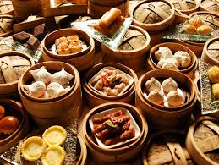
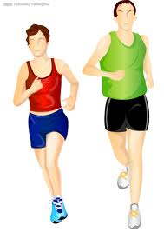
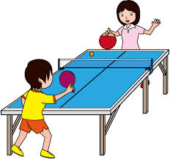
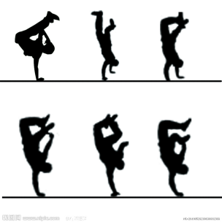
你和朋友夏天喜欢做什么？
打篮球
唱歌
跑步
游泳
爬山
看电影
吃美食
打桌球
跳街舞
Images from clipart

Slide 4
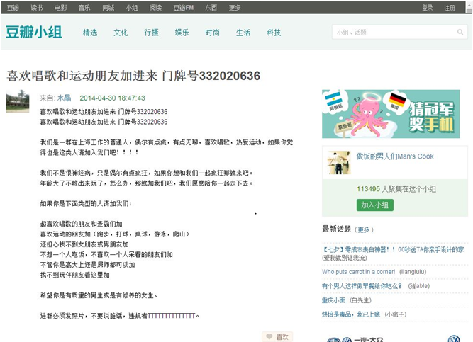
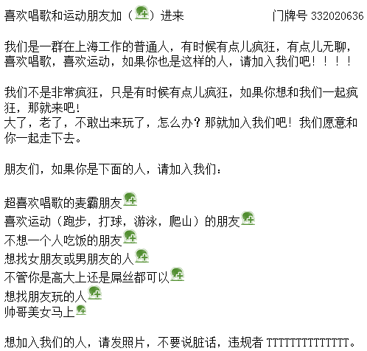
Adapted from http://www.douban.com/group/topic/52138903/
Please find the title of this web post!
(30 seconds)
Notes:
Show students the slide and ask 这是什么？
Guide students attentions towards the title and the first line:
What does the title and the first line say?
What is the contents in the covered area?
What is the purpose of this post?
3.

Slide 5
Adapted from http://www.douban.com/group/topic/52138903/
Notes:
Show students the slide and ask 这是什么？
Guide students attentions towards the title and the first line:
What does the title and the first line say?
What is the contents in the covered area?
What is the purpose of this post?
3.

Slide 6
Adapted from http://www.douban.com/group/topic/52138903/
With your partner, read the title and the first line. Write in Chinese on your paper:
Discuss the meaning of the title.
Guess the contents of this post.
Guess the purposes of this post.
Notes:
Show students the slide and ask 这是什么？
Guide students attentions towards the title and the first line:
What does the title and the first line say?
What is the contents in the covered area?
What is the purpose of this post?
3.

Slide 7
Adapted from http://www.douban.com/group/topic/52138903/
By yourself, read the article (3 minutes)
1. Circle the characters “人” and “朋友”
Notes:
Show students the slide and ask 这是什么？
Guide students attentions towards the title and the first line:
What does the title and the first line say?
What is the contents in the covered area?
What is the purpose of this post?
3.

Slide 8
Adapted from http://www.douban.com/group/topic/52138903/
Notes:
Skim the article:
Circle the words of the types of people. Repeated words?

Slide 9
Adapted from http://www.douban.com/group/topic/52138903/
By yourself, underline the activities you do after school.
(3 minutes)
Notes:
Show students the slide and ask 这是什么？
Guide students attentions towards the title and the first line:
What does the title and the first line say?
What is the contents in the covered area?
What is the purpose of this post?
3.

Slide 10
Adapted from http://www.douban.com/group/topic/52138903/
Notes:
Skim the article:
Circle the words of the types of people. Repeated words?

Slide 11
Adapted from http://www.douban.com/group/topic/52138903/
By yourself, highlight the words of the type of “people”.
(3 minutes)
Notes:
Show students the slide and ask 这是什么？
Guide students attentions towards the title and the first line:
What does the title and the first line say?
What is the contents in the covered area?
What is the purpose of this post?
3.

Slide 12
Adapted from http://www.douban.com/group/topic/52138903/
Notes:
Skim the article:
Circle the words of the types of people. Repeated words?

Slide 13
表示biǎoshì: mean
“一个喜欢唱歌的人” 表示:
这个人很喜欢_____________________
“一个爱打球的人” 表示 :
这个人很爱_______________________
“一个没有朋友的人” 表示:
_________________________________
唱歌
打球
这个人没有朋友。

Slide 14
Adapted from http://www.douban.com/group/topic/52138903/
Notes:
Skim the article:
Circle the words of the types of people. Repeated words?

Slide 15
Adapted from http://www.douban.com/group/topic/52138903/
Images from clipart.
Notes:
Skim the article:
Circle the words of the types of people. Repeated words?

